Slide 1
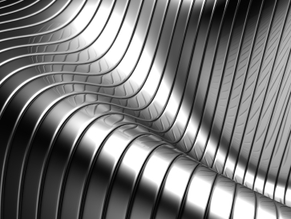
higher Design & Manufacture
Metal Theory

Slide 2


Learning intentions & success criteria
Learning Intentions
Introduction and overview of metals and their properties.
Success Criteria
State and explain different properties of metals.
Name examples of different types of metal.

Slide 3
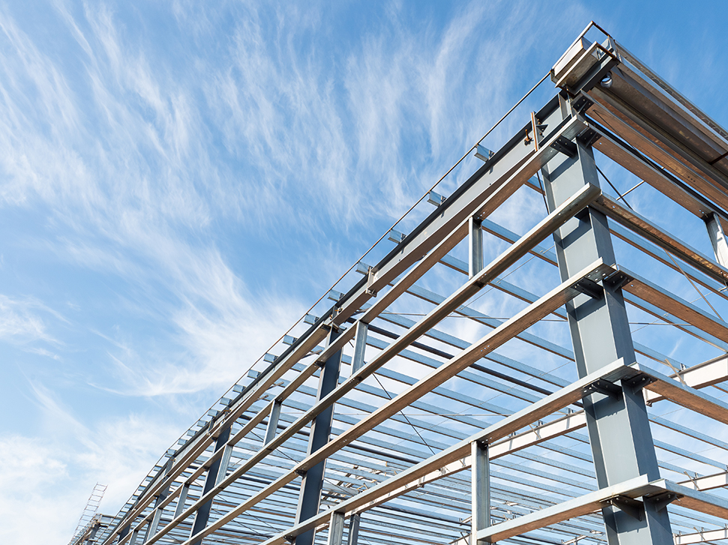
introduction
Metals have been mastered for the use in many things for thousands of years, such as:
  Iron and bronze for tools and weapons
  Steel for use in construction
  Gold and Silver for jewellery and decoration
  Plutonium and Uranium for fuel

Slide 4
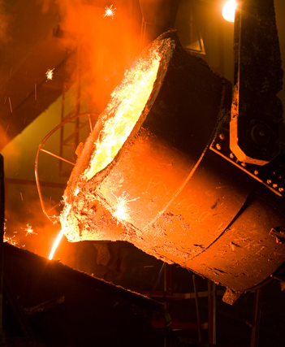
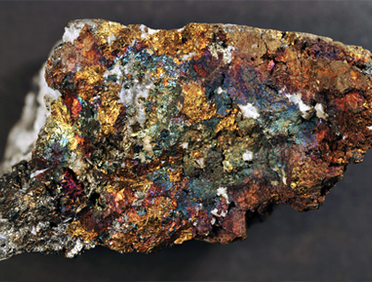
Where does metal come from?
Metals come from the ground and are extracted from their ORES.
Ores are a mixture of rock and metal.
These must be separated by a process called SMELTING, i.e. applying heat.

Slide 5
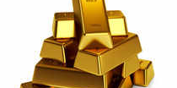
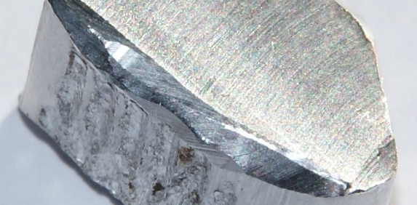
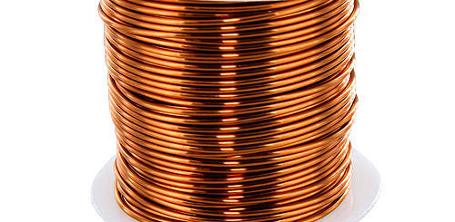
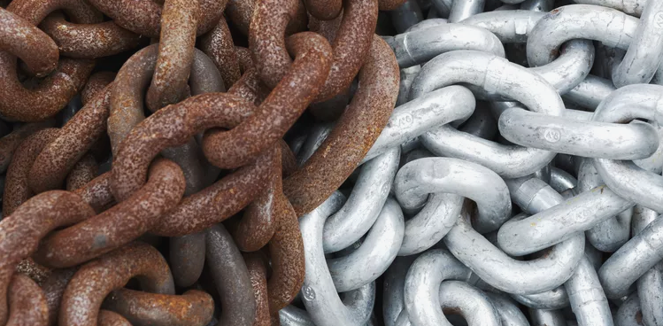
Pure metals
A pure metal is a metal that contains atoms of only one type of metallic element. There are around 95 pure metals in the periodic table.
Examples include:
    Gold
    Aluminium
    Copper
    Iron

Slide 6
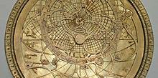
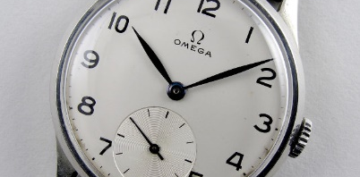
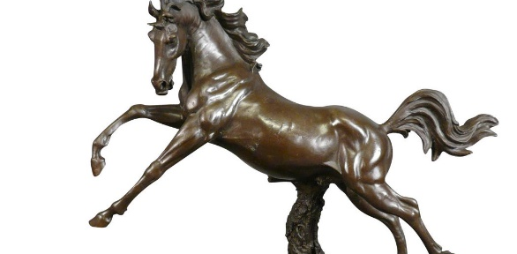
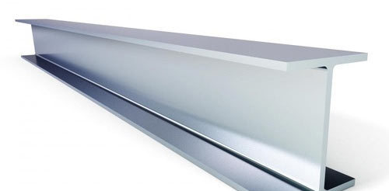
alloys
An alloy is a mixture of a PURE METAL and either:
    Other pure metals
    A non-metal, e.g. Carbon
Examples include:
    Brass (Copper and Zinc)
    Duralumin (Aluminium and Copper)
    Bronze (Copper and Tin)
    Steel (Iron and Carbon)

Slide 7
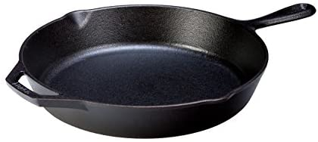
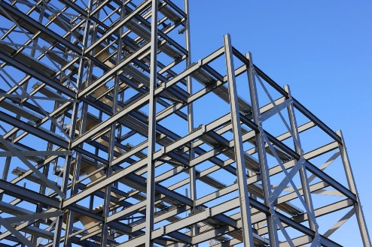
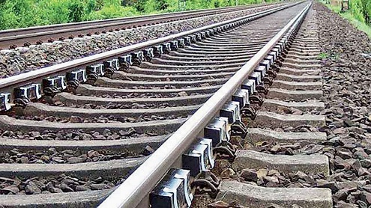
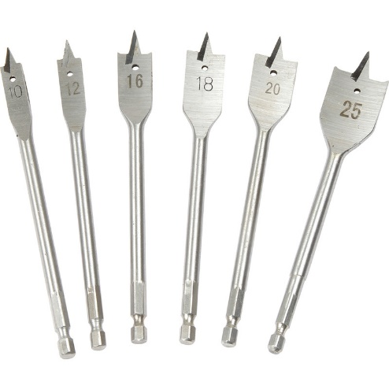
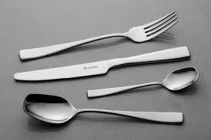
Ferrous metals
A ferrous metal is:
    Metals and Alloys that contain Iron
    They are usually magnetic
    They rust
Examples include:
    Cast Iron (cooking pans)
    Mild Steel (structural steel, signs, wire)
    High Carbon Steel (railways, chisels)
    High Speed Steel (cutting tools)
    Stainless Steel (cutlery, cookware)

Slide 8
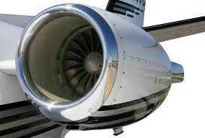

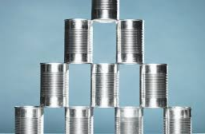
Non-Ferrous metals
A ferrous metal is:
    Metals and Alloys that DOES NOT contain Iron
    They are usually NON-magnetic
    They DO NOT rust
Examples include:
    Aluminium (cans, foils, aeroplane parts)
    Copper (wiring, construction, plumbing)
    Tin (cans, solder)

Slide 9
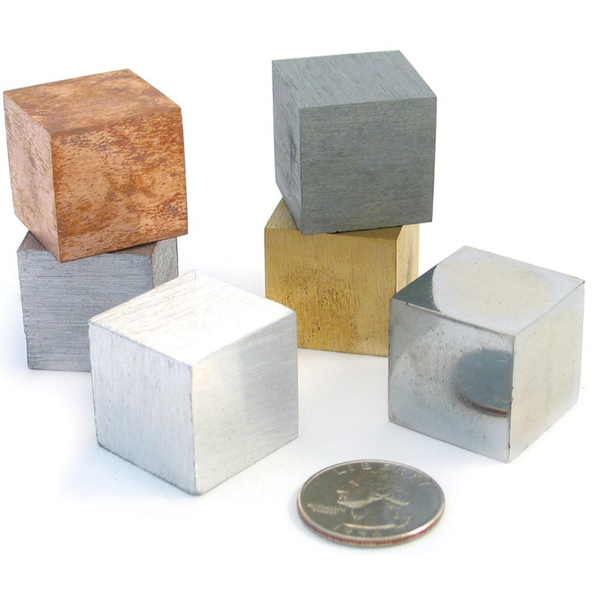
Properties of metals
To understand why we use particular metals for particular products or jobs, we must understand their properties.
There are a number of properties you must remember to be able to describe your answers in detail in tests, exams and in your assignments.

Slide 10
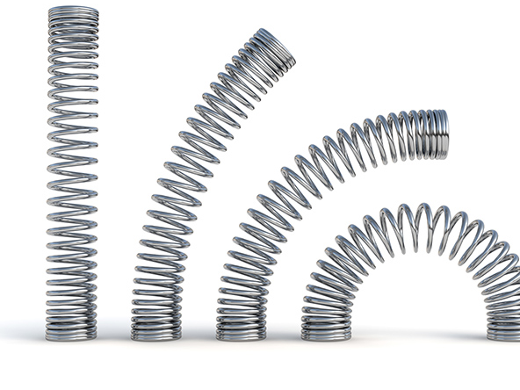
elasticity
The ability to return to shape after deformation.

Slide 11
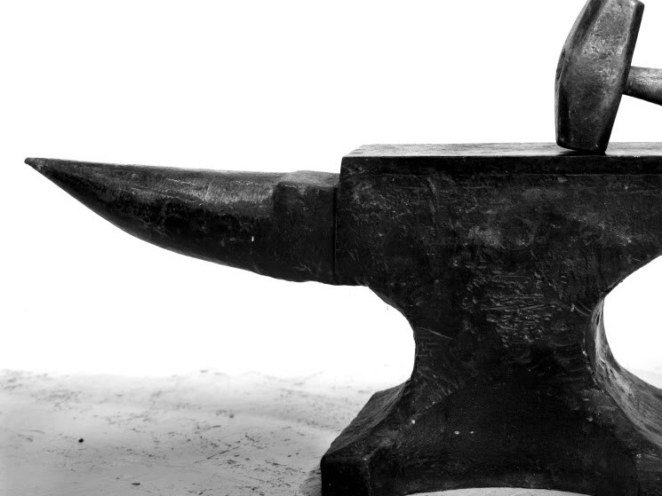
toughness
The ability to withstand sudden loading (from impact resistance).

Slide 12
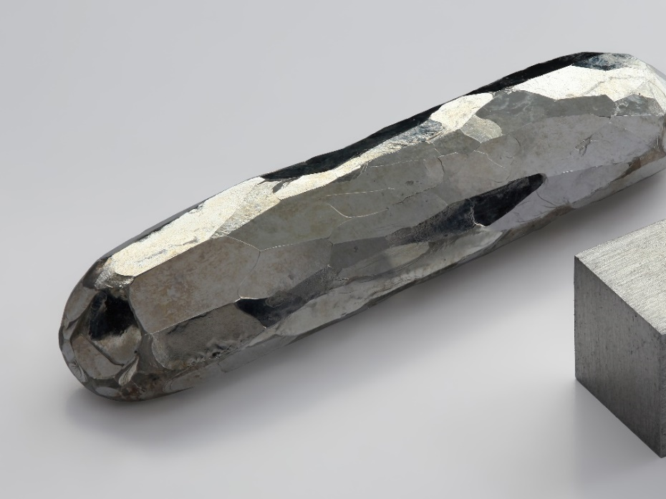
hardness
Resistance to wear or indentation.
If two metals are rubbed together, the harder metal with scratch the softer one.

Slide 13
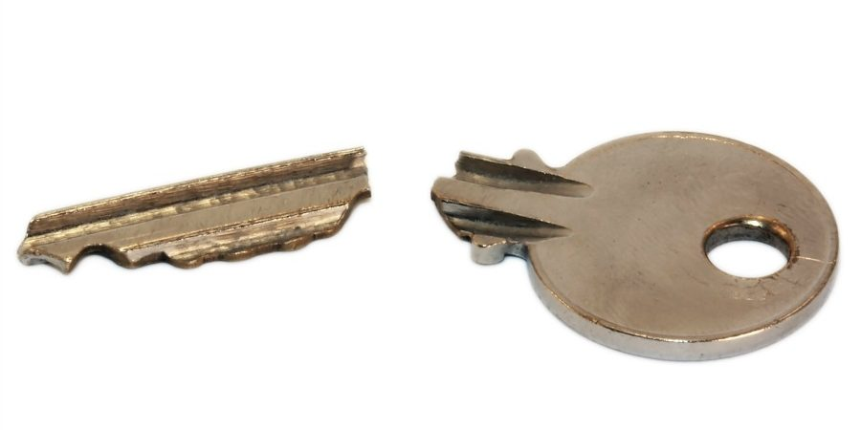
brittleness
The ability to be snapped easily.

Slide 14
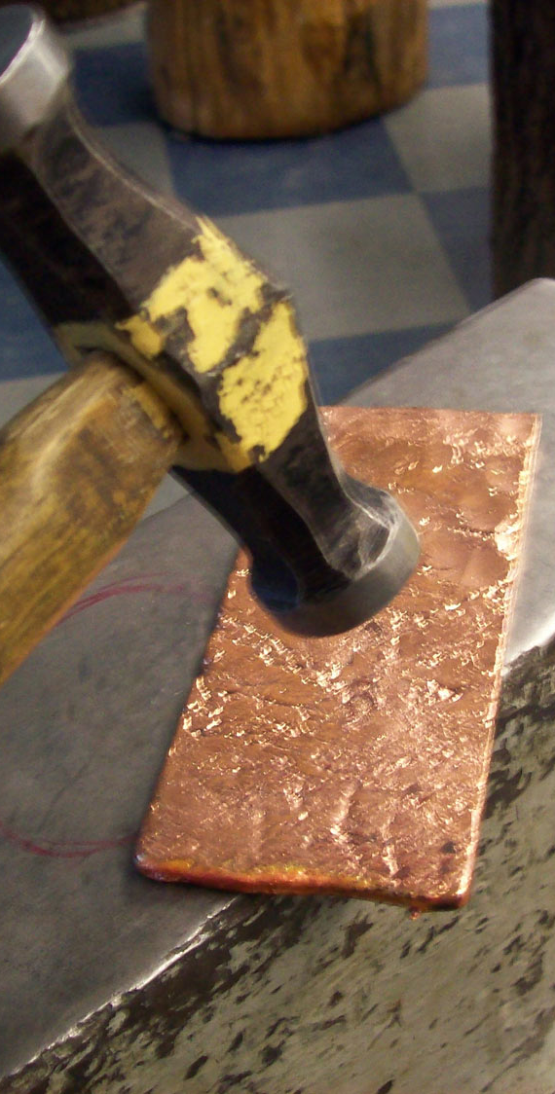
Malleability
The ability to be hammered into shape without fracturing.

Slide 15
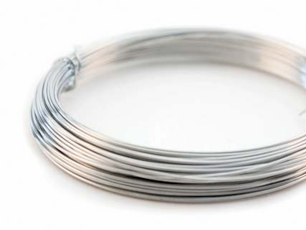
ductility
The ability to be stretched (drawn) and to a reduced cross-section (thinner).

Slide 16
Ferrous metal properties
Name | Composition | Properties | Uses
Cast Iron | Iron + 3.5% Carbon | Smooth, soft core, strong when compressed, cant be bent or forged. | Vices, lathe beds, garden bench ends and car brake drums.
Mild Steel | Iron + 0.15 - 0.35% Carbon | Ductile, malleable, tough, high tensile strength, corrodes easily. Easily welded. | Car bodies, machine bodies, nuts and bolts, screws, nails and girders.
High Carbon Steel (tool steel). | Iron + 0.8 - 1.5% Carbon | Very hard, rather brittle, difficult to cut, poor resistance to corrosion. | Tool blades e.g. Saws, chisels, screwdrivers, centre punches and so on.
High Speed Steel | Iron + Tungsten, chromium vanadium. | Very hard, heat resistant, remains hard when red. | Drills, lathe cutting tools, milling cutters, power hacksaw blades and so on.
Stainless steel | Iron + chromium, nickel, magnesium. | Tough, hard, corrosion resistant, wears well, difficult to cut, bend and file. | Cutlery, sinks, teapots, kitchen ware, saucepans and so on.

Slide 17
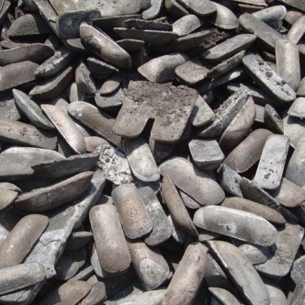
Ferrous Metals
Iron is the basis of all ferrous alloys.
Pure iron is of little practical use as a material.
Iron ore is first processed into pig iron from which a range of useful metals can be produced by heating and alloying processes. These include the addition and careful control of the carbon content.
Most cast iron is derived from scrap iron and scrap steel with only some pig iron added. Most pig iron undergoes a further refining process before being turned into steel, steel is produced by reducing the carbon content.

Slide 18
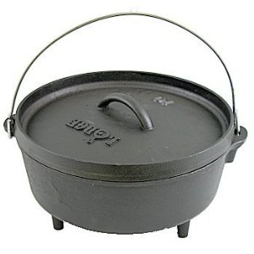
Ferrous Metals cont.
Metals mixed with Iron
  Cast Iron
    Contains approximately 2-4% carbon.
    Hard, relatively brittle alloy of iron and carbon which can be readily cast in a mould

Slide 19
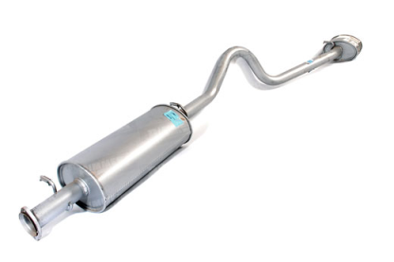
Ferrous Metals cont.
Metals mixed with Iron
  Mild Steel
    Contains approximately 0.05–0.25% carbon making it malleable and ductile.
    Mild steel has a relatively low tensile strength, but it is cheap and easy to form; surface hardness can be increased through carburizing.
    Is typically used for building frames, cookware, machinery, pipelines, gates, fences etc.

Slide 20
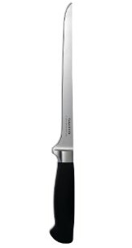
Ferrous Metals cont.
Metals mixed with Iron
  High Carbon Steel
    Have a carbon content in the range of 0.30–1.70%
    Very strong, used for knives, springs, edged tools, and high-strength wires etc.

Slide 21
Non- Ferrous metal properties
Name | Composition | Properties | Uses
Aluminium | Pure Metal | Strong, light, malleable, ductile, difficult to weld, non-toxic, resists corrosion, conducts electricity and heat well and polishes well. | Kitchen foil, drinks cans and saucepans.
Duralumin | Alloy = Aluminium + Manganese, magnesium. | Stronger than pure aluminium and nearly as strong as mild steel but only one third the weight. | Greenhouses, window frames and aircraft bodies.
Copper | Pure Metal | Tough, ductile, malleable, conducts heat and electricity well, corrosion resistant, solder and polishes well. | Electrical wire, central heating pipes, circuit boards, saucepan bases.

Slide 22
Non Ferrous Metals
This group of metals does not contain iron and therefore will withstand most conditions.
Common examples are copper, aluminium, tin and lead, precious metals such as gold and silver, metals used in small amounts such as mercury and platinum and new metals such as vanadium and zirconium.

Slide 23
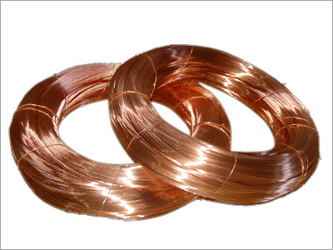
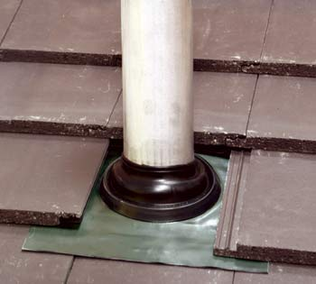
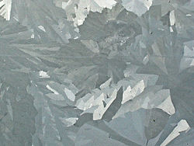
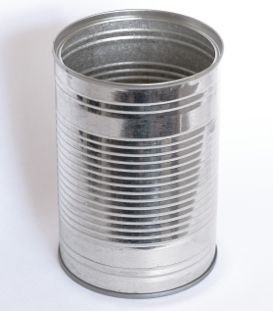
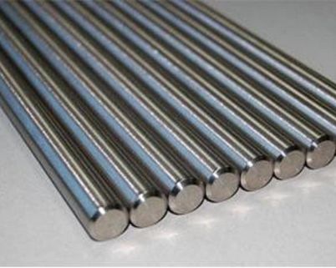
Non Ferrous Metals cont.
Aluminium
Copper
Tin
Lead
Zinc
Copper
Lead
Zinc
Tin
Aluminium

Slide 24
Aluminium and Copper
Aluminium is the earths most plentiful metal, its lightness and strength make it the most widely used non-ferrous metal.
It is difficult to refine and requires large quantities of electrical energy in the smelting process.
Aluminium is alloyed with copper to form duralumin which has almost the same strength as steel but with only 30% of the weight.
Copper is the most important electrical conductor and is also the major bass metal in brass and bronze alloys.
Copper possesses three important properties, high electrical and thermal conductivity, high ductility and high corrosion resistance.

Slide 25
Ferrous Alloys
Alloying refers to the bringing together of two or more metals, often with another element to improve the properties.
Ferrous alloys range from carbon steels with 98% iron to high alloy steels with up to 50% of other elements. Alloy steels contain other elements such as chromium, nickel, vanadium etc.
These elements are added in small quantities of under 5% to improve strength and hardness. Larger quantities are added in improve corrosion or wear resistance at high temperatures. Examples of ferrous alloys are stainless steel, where chromium is added and high speed steel where tungsten is used.
It is important to know the properties of various grades of steel to ensure the correct one is chosen for the correct application.

Slide 26
Non Ferrous Alloys
Brass
  Alloy of copper and zinc
  Used extensively in musical instruments such as horns and bells for its acoustic properties
Bronze
  Alloy of copper and tin
  It is hard and brittle, and it was particularly significant in antiquity
Duralumin
  Alloy of Aluminium, copper, manganese and magnesium

Slide 27
Metals
These metal ‘Ores’ are processed using different methods (depending on the type of Ore) to produce usable materials.
Metals are usually found combined with other elements/minerals in the form of oxides and sulphates. Gold is the only metal that can be found in its pure state.
Metals are split into two categories:
Ferrous Metals = Contain Iron, usually rust so need to be protected (painted etc). Magnetic.
Non Ferrous Metals = Do not contain Iron. Better corrosion resistant, Non Magnetic.
Elasticity – ability to return to shape after deformation.
Introduction
Brittleness – ability to be snapped easily.
Toughness – Impact Resistant, can withstand sudden loading.
Alloys are mixtures of metals and/or other elements combined together.
The most common ferrous alloy is Steel, Carbon Steels, High alloy Steels and so on
Ductility – ability to be stretched to reduce the cross-section.
Properties
Metals
Alloys
Most others will be Non Ferrous and can be divided into Light, Heavy and Heat Resistant Alloys.
Malleability – can be hammered into shape without fracturing.
Hardness – resistance to wear or indentation.
Forms
They come in a variety of shapes and forms because metal is more difficult to resize/change.
Bar
Ferrous Alloys especially Steel form 90% of the worlds metal usage because of low cost and versatility.
Angle
Tube
Rod
Flat Strip

Slide 28
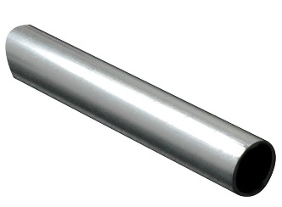
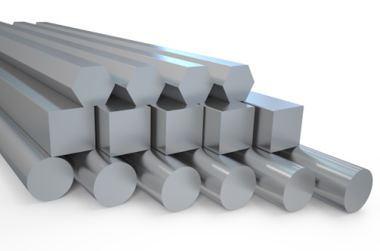
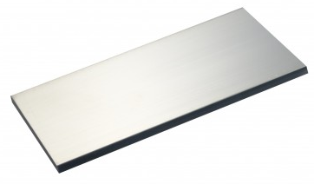
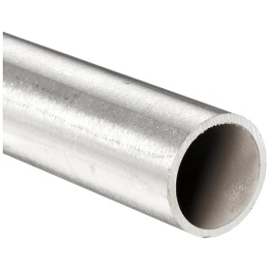
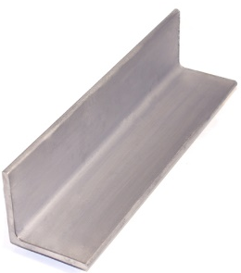
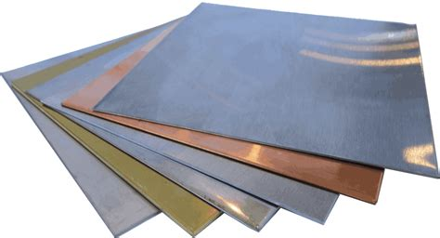
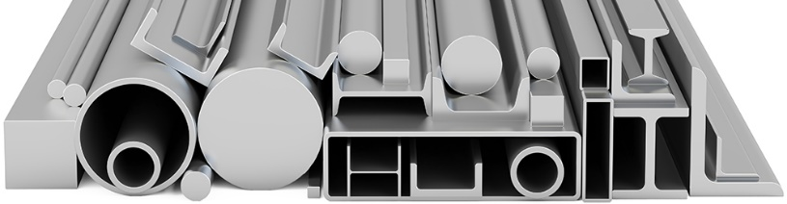
Forms of metal
1.
2.
Rod
Bar (available in a range of cross-sections, e.g. square, triangular, hexagonal etc.).
Flat Strip
Tube
Angle
Sheet (0.1-10mm thick)
Various other channel sections
3.
4.
5.
6.
7.

Slide 29
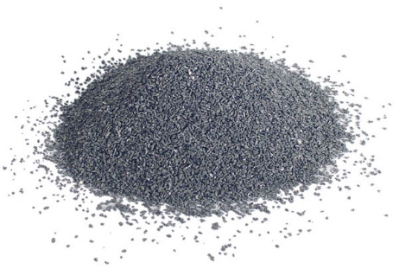
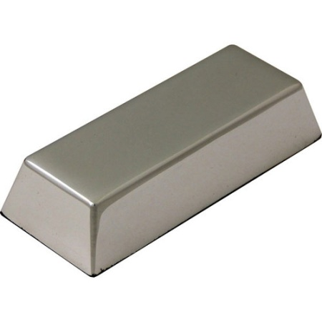
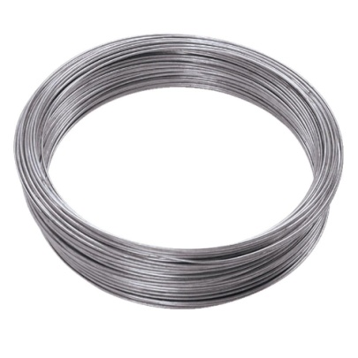
Forms of metals
Powder (fine metal powder can be used for 3D printing).
Ingots (large blocks of metal which are melted down to use for moulding metals).
Wire (available in a range of thicknesses and lengths).

Slide 30
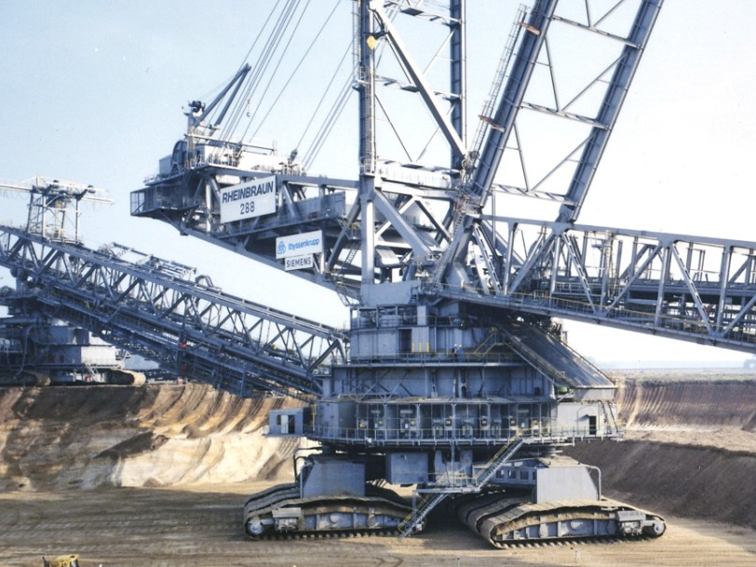
Metals and the environment
Mining and processing metallic ores into useful products has a huge environmental impact.
They all differ in their impact, but generally:
  Require energy to be extracted
  Produce harmful pollution
  Destructive effect on the landscape
  Can be absorbed by humans (e.g. if leaked into water systems)

Slide 31
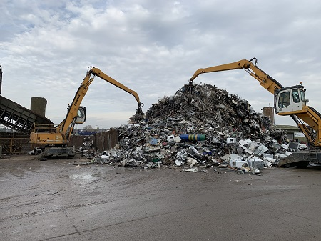
Recycling metals
Recycling metals has become very important for the environment
The value of scrap metal has become increasingly more valuable
Recycling metal requires (in most cases), less energy than mining, processing and manufacturing new metals.

Slide 32
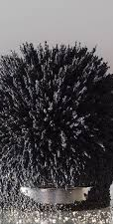
Know your metals
Iron: second most common metallic element on Earth. Pure iron is very soft. Rusts with exposure to air and water. Is the most common to make alloys.
Nickel: often alloyed with other metals, including steel to manufacture guitar strings, batteries and coins. It is resistant to corrosion therefore is often used to simulate decorative silver.
Tin: one of the earliest used metals, used with copper to make bronze. Non-toxic, therefore is often used for food cans.
Aluminium: most common metal on Earth, found in the Bauxite ore. Takes a large amount of energy to extract. It is light weight and has a low melting point.

Slide 33
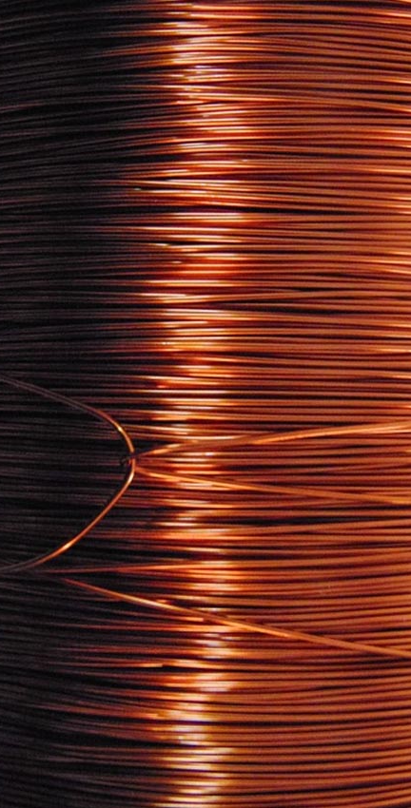
Know your metals
Steel: alloy of iron and carbon. The amount of carbon added with determine the strength and malleability of steel.
Copper: most commonly used in electrical wires and pipes as it is very malleable and ductile. Copper alloys kill bacteria and are used for sterile surfaces.
Brass: alloy of zinc and copper, most commonly used to manufacture a range of objects from cooking pots to door knobs. It is malleable and corrosion resistant.
Pewter: alloy of tin, bismuth, antimony and copper. It has a very low melting point and is very malleable. It has been used for thousands of years to create decorative items like tableware and plates.

Slide 34
Metal Processes
The following processes are used in industry, which we will be looking at in more detail:
  Die Casting
  Sand Casting
  Press Forming
  Piercing and Blanking
  Drop Forging

